Slide 1

ECE 530 Cloud Computing
Ioannis Papapanagiotou
Introduction to Cloud Edge

Slide 2
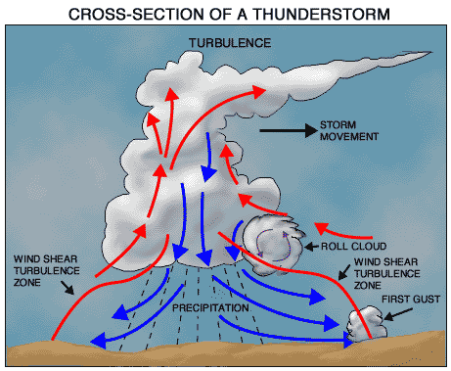
How are cloud structured?
Clients talk to clouds using web browsers or the web services standards
But this only gets us to the outer “skin” of the cloud data center, not the interior
Consider Amazon: it can host entire company web sites (like Target.com or Netflix.com), data (S3), servers (EC2) and even user-provided virtual machines!

Slide 3



Big picture overview
Client requests are handled in the “first tier” by
PHP or ASP pages
Associated logic
These lightweight services are fast and very nimble
Much use of caching: the second tier
1
1
1
1
1
1
2
2
2
2
2
1
2
Shards
1
2
Index
1
2
DB

Slide 4
Many styles of system
Near the edge of the cloud focus is on vast numbers of clients and rapid response
Inside we find high volume services that operate in a pipelined manner, asynchronously
Deep inside the cloud we see a world of virtual computer clusters that are scheduled to share resources and on which applications like MapReduce (Hadoop) are very popular

Slide 5
In the outer tiers replication is key
We need to replicate
Processing: each client has what seems to be a private, dedicated server (for a little while)
Note that is seems to be a private dedicated server.
Data: as much as possible, that server has copies of the data it needs to respond to client requests without any delay at all.
Customer data are not replicated in the front-end layer.
Control information: the entire structure is managed in an agreed-upon way by a decentralized cloud management infrastructure

